Slide 1

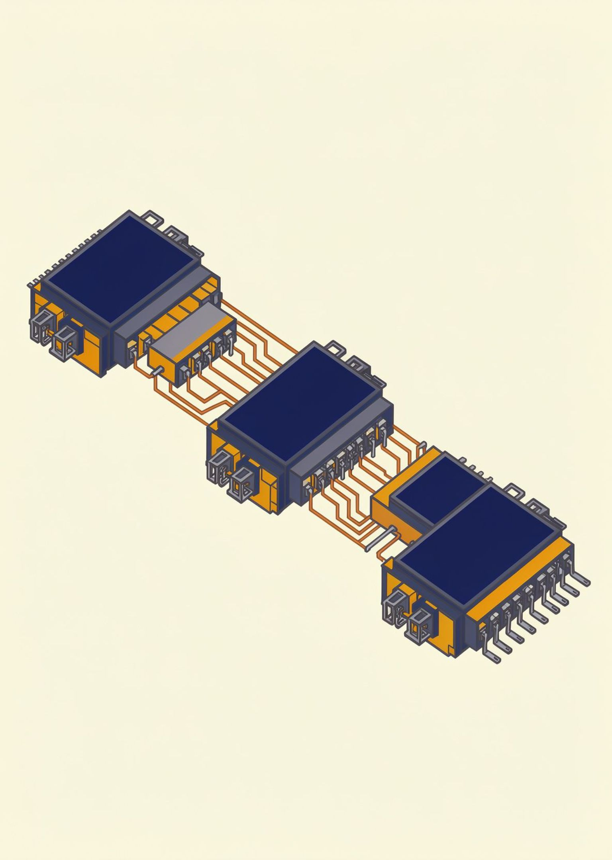
DIGITAL DESIGN · COMPUTER ARCHITECTURE
4-Bit
Ripple Carry
Adder
Digital Design and Computer Architecture
SECTION - 4
PRESENTED BY :
VIJAY -2620030270
SAI VIKRANTH -2620030268
GAYATHRI - 2620030290
AKSHAYA -2620030308
01 / 07
Notes:
Introduce the 4-bit ripple carry adder as a compact example of how simple logic blocks become a multi-bit arithmetic circuit.

Slide 2
Introduction and Objective
LECTURE · 01
4-Bit Ripple Carry Adder
Introduction
1
A 4-bit ripple carry adder (RCA) adds two 4-bit binary numbers using four cascaded full adders.
ORIENTATION
2
Purpose
Design and verify the 4-bit RCA in Logisim, and explain how the carry ripples from bit 0 to bit 3.
3
Scope
Full-adder theory, the Logisim implementation, simulation results, and applications with limitations.
Binary arithmetic
02 / 07
Notes:
Frame the session around one circuit and four questions: what a full adder does, how four stages connect, how to verify the outputs, and why carry delay matters.

Slide 3
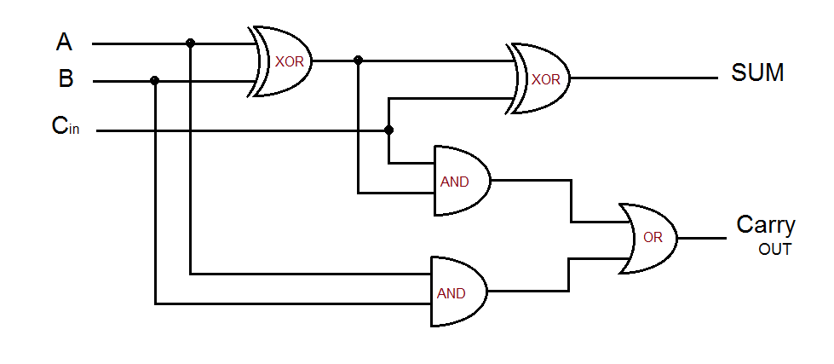

Slide 4
Theory and logic circuit
03 · THEORY
Full adder: adds bits A, B, and carry-in Cin, producing Sum and carry-out Cout.
Sum = A ⊕ B ⊕ Cin Cout = AB + BCin + ACin
4-Bit Ripple Carry Adder
A | B | Cin | Sum | Cout
0 | 0 | 0 | 0 | 0
0 | 0 | 1 | 1 | 0
0 | 1 | 0 | 1 | 0
0 | 1 | 1 | 0 | 1
1 | 0 | 0 | 1 | 0
1 | 0 | 1 | 0 | 1
1 | 1 | 0 | 0 | 1
1 | 1 | 1 | 1 | 1
THEORY
Logic and circuit
4-bit RCA circuit: FA0 → FA1 → FA2 → FA3, with C0 = 0; each carry C1, C2, C3 feeds the next stage and C4 is the final carry.
03 / 07

Slide 5
Circuit design in Logisim
04 · LOGISIM
Four full-adder stages are wired in cascade; each stage adds one bit pair plus the carry from the previous stage.
4-Bit Ripple Carry Adder
IMPLEMENTATION
FA0
FA1
FA2
FA3
A0, B0, C0 = 0
→ S0, C1
A1, B1, C1
→ S1, C2
A2, B2, C2
→ S2, C3
A3, B3, C3
→ S3, C4
Working: addition starts at the least significant stage; each carry must settle before the next stage gives its final sum and the final carry C4.
[PLACEHOLDER: insert your Logisim screenshot of the 4-bit RCA circuit here]
Four-stage design
04 / 07

Slide 6
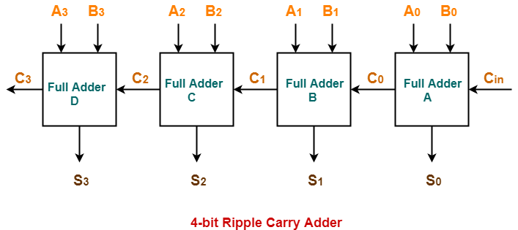

Slide 7
Simulation results
05 · SIMULATION
Full-adder truth table: each input row yields Sum and Cout.
4-Bit Ripple Carry Adder
A | B | Cin | Sum | Cout
0 | 0 | 0 | 0 | 0
0 | 0 | 1 | 1 | 0
0 | 1 | 0 | 1 | 0
0 | 1 | 1 | 0 | 1
1 | 0 | 0 | 1 | 0
1 | 0 | 1 | 0 | 1
1 | 1 | 0 | 0 | 1
1 | 1 | 1 | 1 | 1
[PLACEHOLDER: Logisim screenshot of simulation output for the 4-bit adder]
[PLACEHOLDER: input-output combinations observed in Logisim]
[PLACEHOLDER: observed S3-S0 and C4 values from your run]
RESULTS
Inputs and outputs
05 / 07

Slide 8

Conclusion and applications
06 · CONCLUSION
Outcome: four cascaded full adders form a working 4-bit RCA.
Advantages: simple design and low complexity.
Limitation: carry delay grows as bit width increases.
Applications: ALUs, processor datapaths, calculators, embedded arithmetic.
Improvements: carry-lookahead, carry-select, or carry-skip adders for faster carry.
4-Bit Ripple Carry Adder
WRAP-UP
GitHub repository / project files: [PLACEHOLDER: insert GitHub repository link]
Applications and next steps
06 / 07

Slide 9


Geo Tag Photo

Slide 10
Thank You
07 / 07

